Slide 1




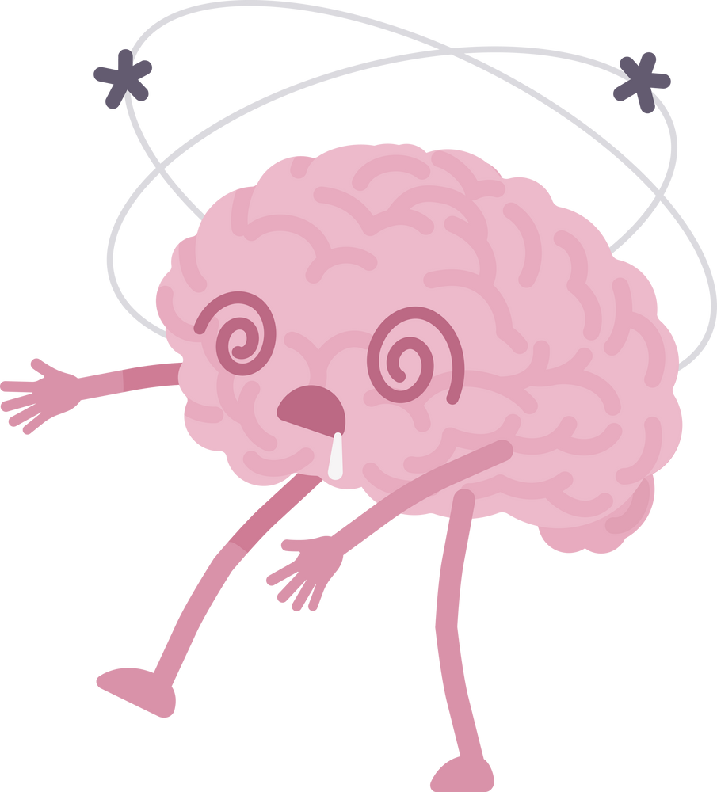

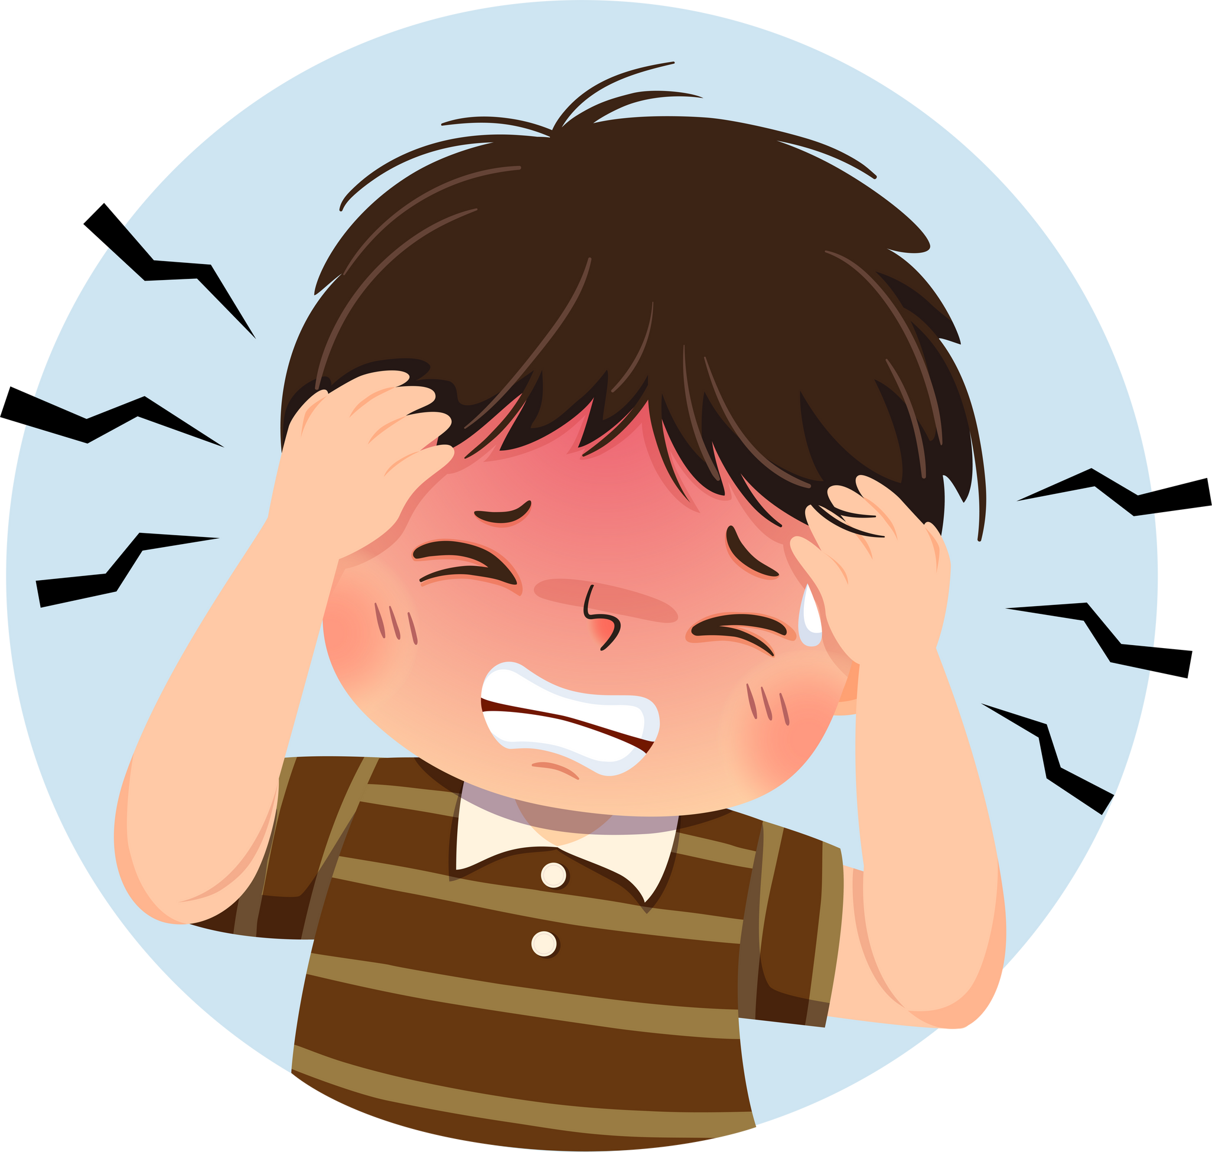



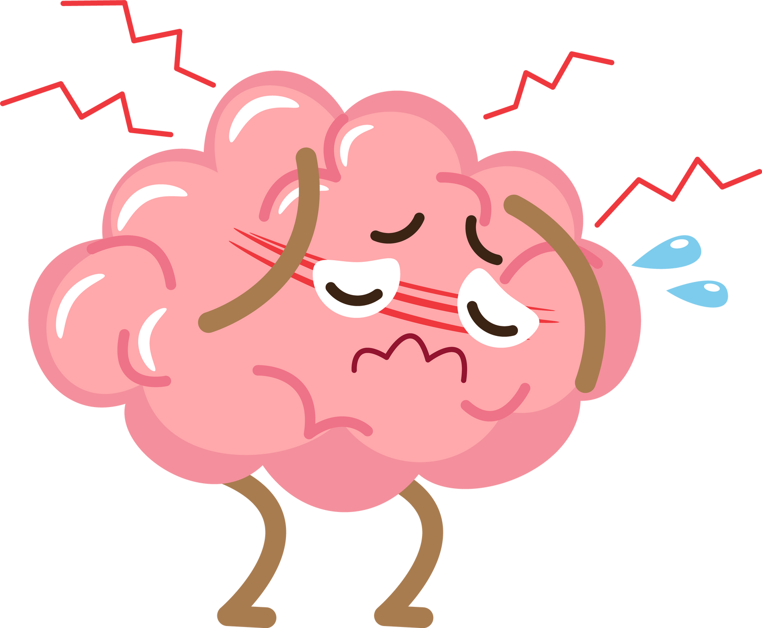
UNDERSTANDING MIGRAINE
-By Deepak Rana
Nims College
BCA 6th Sem

Slide 2



01
WHAT IS
MIGRAINE
06
DISTRIBUTION OF FEATURES
CAUSES OF MIGRAINE
07
HEATMAP
TABLE OF CONTENT
02
SIGNS OF MIGRAINE
SYMPTOMS OF MIGRAINE
08
CORRELATION
03
04
OBJECTIVES
09
LIMITATION
10
Conclusion
SOME IMPORTANT FEATURES OF MIGRAINE
05

Slide 3
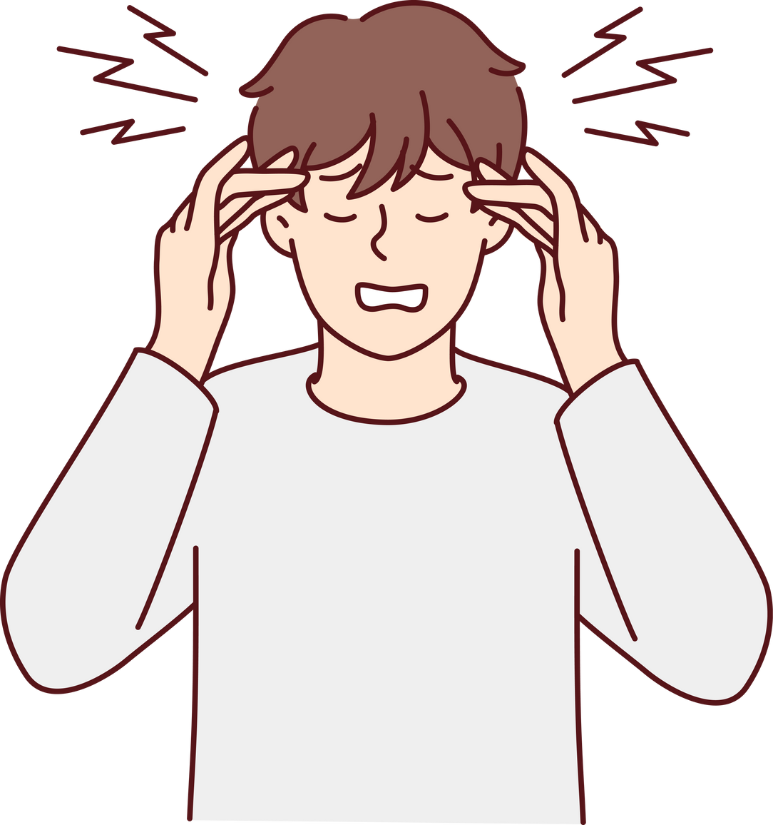
WHAT IS MIGRAINE ?
A migraine is a neurological disorder characterized by recurrent episodes of moderate to severe headache, often accompanied by symptoms such as nausea, vomiting, and sensitivity to light and sound. The headache typically presents as a throbbing or pulsating pain, usually on one side of the head, and can last from a few hours to several days and can significantly impact daily life.
Causes of Migraine:
🧠1. Neurological
🧬2. Genetic
🧪Chemical Imbalances
The causes of migraine are complex and not fully understood, but researchers believe they result from a combination of genetic, neurological, and environmental factors.
Migraines often run in families.
Certain genes affect brain signaling and pain regulation.
Brain activity changes: Abnormal electrical activity may trigger migraine symptoms.
When work is not aligned with personal values ​​or goals, individuals can become demotivated.

Slide 4
SIGNS OF A MIGRAINE
Migraine signs typically begin with early warning symptoms like mood changes, food cravings, and fatigue, known as the prodrome phase. Some individuals experience an aura, which includes visual disturbances such as flashing lights or blind spots. The main migraine attack is marked by intense, throbbing head pain—often on one side; along with nausea, and sensitivity to light, sound, or smells. After the headache, people often feel drained or confused during the postdrome phase.
Prodrome
Aura
Attack Phase
Postdrome
Mood changes (irritability or depression)
Food cravings
Neck stiffness
Frequent yawning
Constipation or bloating
Increased thirst and urination
Visual disturbances: flashing lights, zigzag lines, blind spots
Sensory symptoms: tingling or numbness in face, hands
Speech/language difficulties
Muscle weakness (in rare cases, like hemiplegic migraine)
Severe throbbing or pulsing pain, often on one side of the head
Nausea and vomiting
Sensitivity to light (photophobia), sound (phonophobia), or smell
Pain worsens with physical activity (e.g., walking, climbing stairs)
Duration: 4 to 72 hours
Feeling drained or “hungover”
Confusion, difficulty concentrating
Dizziness or mood swings

Slide 5

SYMPTOMS OF MIGRAINE:
🤮 VOMIT
The act OF THROWING UP;
COMMON IN
SEVERE MIGRAINE ATTACKS.
💡 PHOTOPHOBIA
DISCOMFORT OR PAIN IN THE EYES WHEN EXPOSED TO LIGHT.
🔊 PHONOPHOBIA
EXTREME SENSITIVITY TO SOUND—NORMAL NOISES MAY FEEL PAINFULLY LOUD.
🗣️ LANGUAGE
TrOUBLE SPEAKING OR FINDING THE RIGHT WORDS (ALSO PART OF AURA).
🤢 NAUSEA
Feeling sick OR QUEASY,
OFTEN LEADING TO A
LOSS OF APPETITE
OR DISCOMFORT.
🧠 MOTOR
DIFFICULTY MOVING MUSCLES NORMALLY; MAY FEEL WEAKNESS OR LACK OF COORDINATION.
✋ SENSORY
TINGLING OR NUMBNESS, USUALLY IN THE FACE, ARMS, OR LEGS.
👁️ VISUAL
SEEING FLASHES, ZIGZAG LINES, OR BLIND SPOTS—OFTEN CALLED "AURA."
🎧 TINNITUS
BUZZING OR RINGING SOUNDS IN THE EARS WITHOUT AN EXTERNAL SOURCE.
👀 DIPLOPIA
DOUBLE VISION—SEEING TWO IMAGES OF A SINGLE OBJECT.
🌪️ VERTIGO
A SPINNING SENSATION
OR LOSS OF BALANCE.
🔲 DEFECT
Missing PARTS IN THE FIELD OF VISION, LIKE BLIND SPOTS.
⚡ DPF (DYSFUNCTIONAL PHYSICAL FACTOR)
TRIGGERS TIED TO PHYSICAL CONDITIONS—LIKE MENSTRUAL CYCLES OR HORMONAL SHIFTS.
😵 CONSCIENCE
Episodes of cONFUSION, DISORIENTATION, OR PARTIAL LOSS OF CONSCIOUSNESS.
🔥 PARESTHESIA
Unusual skin sensatiONS LIKE TINGLING, PRICKLING, OR “PINS AND NEEDLES.”
👂 HYPOACUSIS
DECREASED ABILITY TO HEAR; SOUNDS MAY SEEM MUFFLED.
🚶 ATAXIA
Lack OF MUSCLE CONTROL,
LEADING TO UNSTEADY
MOVEMENT OR
BALANCE ISSUES.

Slide 6
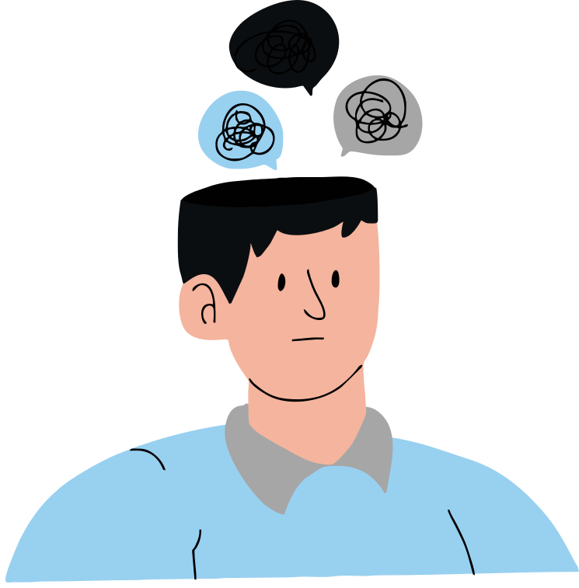
OBJECTIVES:
To study how migraine symptoms spread among patients and how often they occur.
To analyze how migraine symptoms vary across different types of migraines.
Provide insights on how migraine affects people

Slide 7
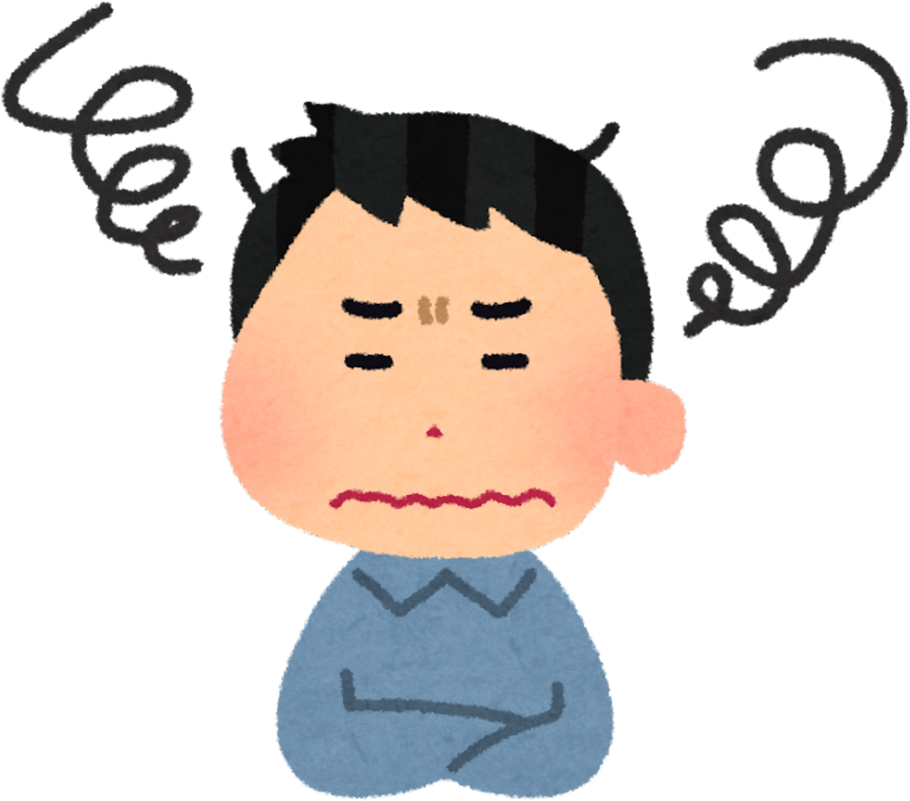
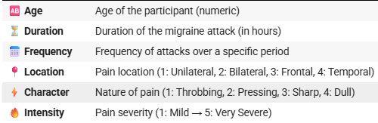
SOME IMPORTANT FEATURES OF MIGRAINE:

Slide 8
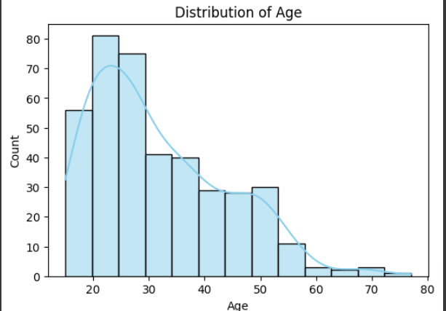
This bar graph shows that migraines are most common
in people aged 15–30, peaking around age 20–25.
After age 30, the number of cases steadily declines, with very few cases after age 60.

Slide 9
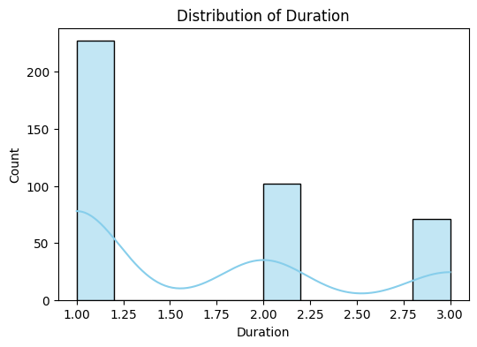
This graph shows that most migraine attacks last around 1 hour, with fewer cases lasting 2 or 3 hours.
👉 Short-duration migraines are more common, while longer attacks are less frequent.

Slide 10
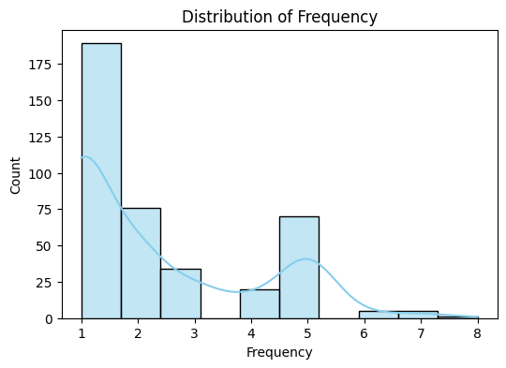
This graph shows that most patients experience 1 migraine attack per period, while fewer have multiple attacks.
👉 Single or low-frequency attacks are most common, with high-frequency cases being rare.

Slide 11
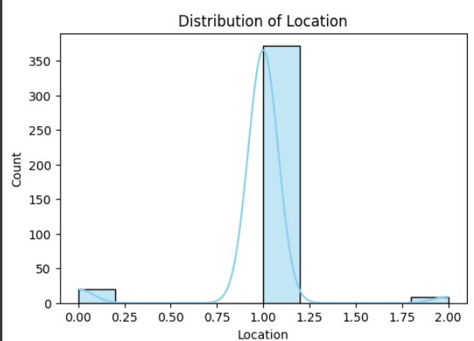
Location of the pain: 1 - Unilateral, 2 - Bilateral, 3 - Frontal, 4 - Temporal.
The graph shows that:
Most patients experience (location 1) unilateral pain (one-sided headaches).
Very few have bilateral (2), frontal (3), or temporal (4) pain.

Slide 12
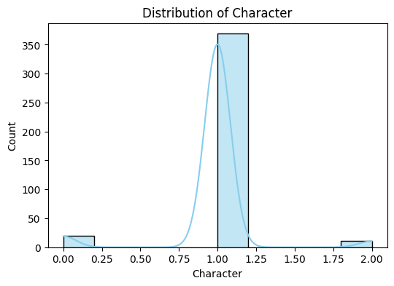
This graph shows that most migraine patients experience throbbing pain (1).
👉 Other pain types like pressing, sharp, or dull are much less common.

Slide 13
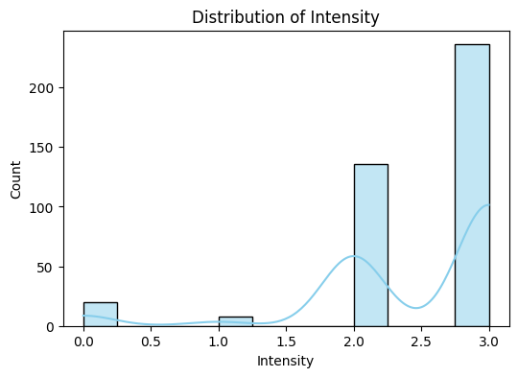
This graph shows that most migraine cases have high pain intensity, with severity levels 3 and above being the most common.
👉 Severe pain is typical, while mild cases are rare.

Slide 14
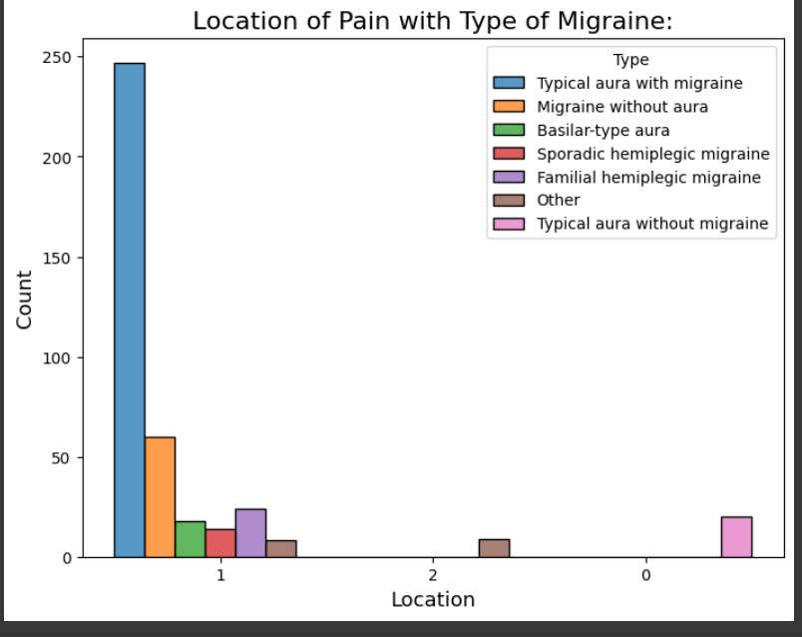
Provide Mental Health Resources
The bar chart shows how location of pain varies with different migraine types. Most people with "Typical aura with migraine" and "Migraine without aura" experience unilateral pain, making it the most common pattern. Other migraine types like "Basilar-type aura" and "Hemiplegic migraines" also mostly involve unilateral pain but are less frequent.

Slide 15
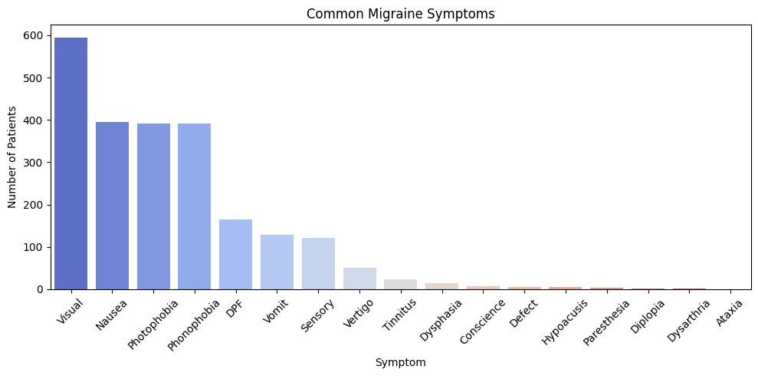
The above chart illustrates the most common symptoms reported by migraine patients. Visual disturbances are the most prevalent, affecting over 600 individuals, followed by nausea, photophobia (light sensitivity), and phonophobia (sound sensitivity), each affecting around 400 patients. Less frequent symptoms include dizziness, vomiting, sensory disturbances, and vertigo. Rare symptoms such as dysarthria, ataxia, and diplopia are reported by very few patients.

Slide 16
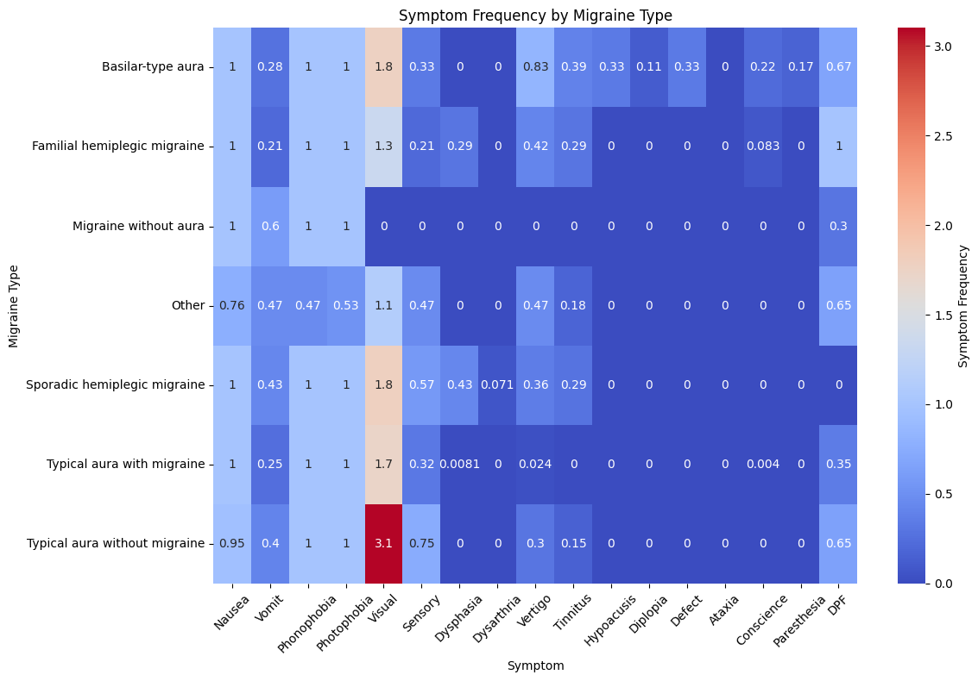
The above heatmap shows the frequency of different symptoms across various migraine types. Each cell represents how often a particular symptom (like nausea, visual disturbances, vertigo, etc.) occurs for each migraine type. Darker red shades indicate higher frequency, while blue shades indicate lower or zero occurrence.

Slide 17
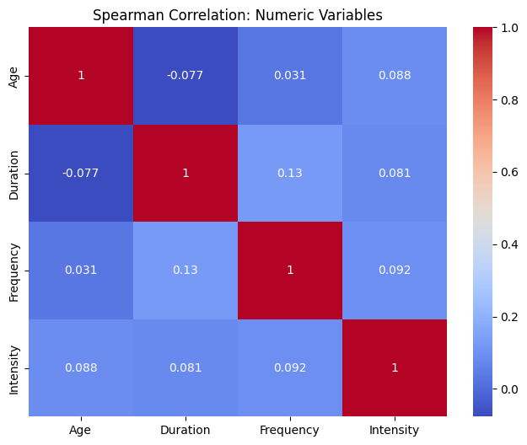
Statistical analysis revealed that pain intensity varies significantly depending on both the location and character of the migraine (p < 0.0001). Additionally, a strong association exists between pain location and character (Chi2 = 655.28, p < 0.0001), suggesting that these two features are often interlinked in how migraines present.

Slide 18
Limitations:
Missing Time-Series Information:
The data lacks temporal information (e.g., when the symptoms occurred), making it difficult to analyze progression or seasonality.
Gender of patients
May affect migraine characteristics and response to treatment.
Response to medication
Helps in predicting treatment outcomes.
Trigger factors (e.g., food, stress)
Important for prevention strategies.

Slide 19
✅ Conclusion
-- Most migraine cases are seen in young adults (20–30 years) with a steady decline as age increases.
– Migraines are predominantly unilateral and throbbing in nature.
– The duration is typically short (around 1 hour), with mild to moderate intensity, and low frequency in most cases.
– The dataset shows potential for basic analysis but lacks depth and diversity in features for more advanced or clinical insights.
– More detailed data (triggers, treatment response, gender, lifestyle factors) is needed to develop accurate classification and personalized recommendations.

Slide 20
THANK YOU
THANK YOU FOR YOUR ATTENTION AND INVOLVEMENT IN THIS SESSION.
--Deepak Rana
BCA 6th Sem

